Slide 1
Notes:
An ‘Acknowledgement’ is a mark of respect to the Traditional Owners of the land and sea and can be given by anyone at QUT functions. The above ‘Acknowledgment’ is appropriate for use at QUT functions such as lectures, in-house training, workshops, conferences, seminars and meetings. ‘Acknowledgments’ are an important part of the Reconciliation process that QUT has a responsibility to foster through its teaching, research and community activities.
A ‘Welcome to Country’ is a formal welcome onto Aboriginal land and can only be given by an Indigenous Elder or person from that area.
‘Welcomes’ are used at major, formal functions where official guests and dignitaries are in attendance.
It is important to ensure that the appropriate representative is invited to perform the ‘Welcome to Country’. Following the decision delivered in late January on the Turrbal and Yugera/Yugarpul overlapping claims over the greater Brisbane area (http://www.theguardian.com/australia-news/2015/jan/27/native-title-claim-to-brisbane-rejected), the current advice from Queensland South Native Title Services is that QUT should not organise or pay for traditional ‘welcomes’ within the CBD area (Gardens Point and Kelvin Grove).
The land where Caboolture campus now stands has had positive native title determinations – so, QUT Caboolture staff/students can choose to acknowledge Kabi Kabi and Jinibara Peoples as the traditional owners, and organise and pay for ‘welcomes’ as appropriate.
For more information contact QUT’s Equity Services on 3138 5601.

Slide 2
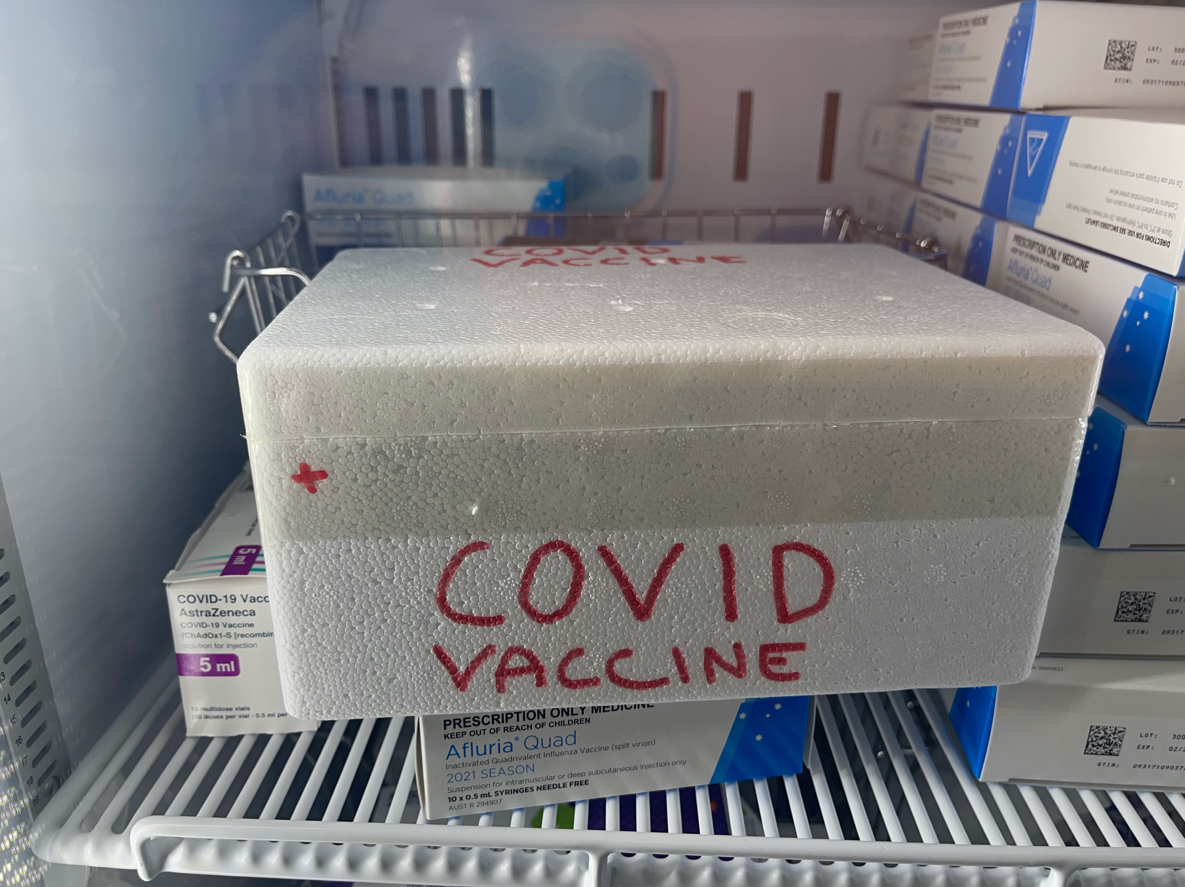

Slide 3
Notes:
An ‘Acknowledgement’ is a mark of respect to the Traditional Owners of the land and sea and can be given by anyone at QUT functions. The above ‘Acknowledgment’ is appropriate for use at QUT functions such as lectures, in-house training, workshops, conferences, seminars and meetings. ‘Acknowledgments’ are an important part of the Reconciliation process that QUT has a responsibility to foster through its teaching, research and community activities.
A ‘Welcome to Country’ is a formal welcome onto Aboriginal land and can only be given by an Indigenous Elder or person from that area.
‘Welcomes’ are used at major, formal functions where official guests and dignitaries are in attendance.
It is important to ensure that the appropriate representative is invited to perform the ‘Welcome to Country’. Following the decision delivered in late January on the Turrbal and Yugera/Yugarpul overlapping claims over the greater Brisbane area (http://www.theguardian.com/australia-news/2015/jan/27/native-title-claim-to-brisbane-rejected), the current advice from Queensland South Native Title Services is that QUT should not organise or pay for traditional ‘welcomes’ within the CBD area (Gardens Point and Kelvin Grove).
The land where Caboolture campus now stands has had positive native title determinations – so, QUT Caboolture staff/students can choose to acknowledge Kabi Kabi and Jinibara Peoples as the traditional owners, and organise and pay for ‘welcomes’ as appropriate.
For more information contact QUT’s Equity Services on 3138 5601.

Slide 4
Young people in rural and remote settings
Ageing population, net reduction in wealth, population decline through out migration.
Two thirds Indigenous people live in rural and remote, reverse demographic in urban settings. Greater the distance from urban centre, larger the Indigenous population relative to non-Indigenous.
Secondary completion and school attendance declines with increasing remoteness.
Declining employment, services and access to public sector employment. Unemployment major issue, with accompanied boredom and drug use.
Limited recreational activities. Lack of transport.
Despite wholesome images of rural life, higher rates of drug and alcohol consumption.

Slide 5
Young people as ‘trouble’ in rural and remote settings
High visibility of young people. Housing overcrowding can mean increased activity in public space.
Legalistic or localistic style of policing?
Successful policing in rural and remote settings is often premised on integration into local community structures and life.
How are ‘crime problems’ defined in rural and regional settings? Who defines the problems?
Police in discrete Indigenous settings in Cape York have described such sites as alienating/’strange’, dystopian ‘warzones’. Described a lack of cross-cultural training.

Slide 6
Crime in discrete Indigenous communities
The literature on Indigenous justice notes that crime rates vary considerably between different Indigenous communities and across different locations. However, there are few in-depth studies focusing on the elements of these communities that might produce these discrepancies or what is a ‘strong community’.
De-homogenising Australian Indigenous peoples’ diverse experiences with the criminal justice system. Colonial and post-colonial terms such as ‘aboriginal’, ‘indigenous’, ‘ATSI’ tend to homogenise diverse cultures and experiences.
Understanding the impacts of diverse geographies on crime and policing, especially as they relates to remote and isolated settings.

Slide 7
TSI context
Torres Start Islands(TSI) present distinct Melanesian cultures, representing a ‘minority within a minority.
Historically, experienced autonomy and cultural continuity, with community policing not afforded mainland groups, with high degree of cultural homogeneity.
Christian mission entrenched and integrated in island cultures early as ‘coming of the light’. Rates of religious participation are very high in the TSI, with 2011 Census recording 81% of people affiliated with a Christian religion, which compared with the state average of 64.3% .
Local cultural life remains strong in the TSI region and over 75 per cent of TSI people living in the Torres Strait Region (TSR) speak a language other than English at home.
Research has indicated a strong sense of traditional culture exists in the Islands, . This includes the teaching of traditional practices, such as food gathering and gardening.
Until recently lack of telecommunications and transport mobility.

Slide 8
TSI Demographics
Demographically, the population is relatively young, resembling other Indigenous communities on the mainland and presenting as a potentially criminogenic factor.
However, culture remains strong on the islands in both traditional and contemporary forms and the socialisation of young people is an important aspect of cultural practices.
Traditional measures of social capital indicate that relatively homogenous and integrated communities exist in the TSR.
Economic indicators such as wealth and employment show relatively high levels of disadvantage in the TSR, as well as economic inequality between Indigenous and non- Indigenous households. In this way, economic capital presents as weaker than social capital.

Slide 9
Offences against the person (rate per 1,000 population), comparison of averages across the Torres Strait Regionª, Queensland Aboriginal communities^{b}, and Queensland State^{c} between January 2001 and July 2018

Slide 10
Offences against property (rate per 1,000 population), comparison of averages across the Torres Stait Regionª, Queensland Aboriginal communities^{b}, and Queensland State^{c} between January 2001 and July 2018

Slide 11
Reported breach of DVO offences (rate per 1,000 population), comparison of averages across the Torres Strait Regionª, Queensland Aboriginal communities^{b}, and Queensland State^{c} between January 2001 and July 2018

Slide 12
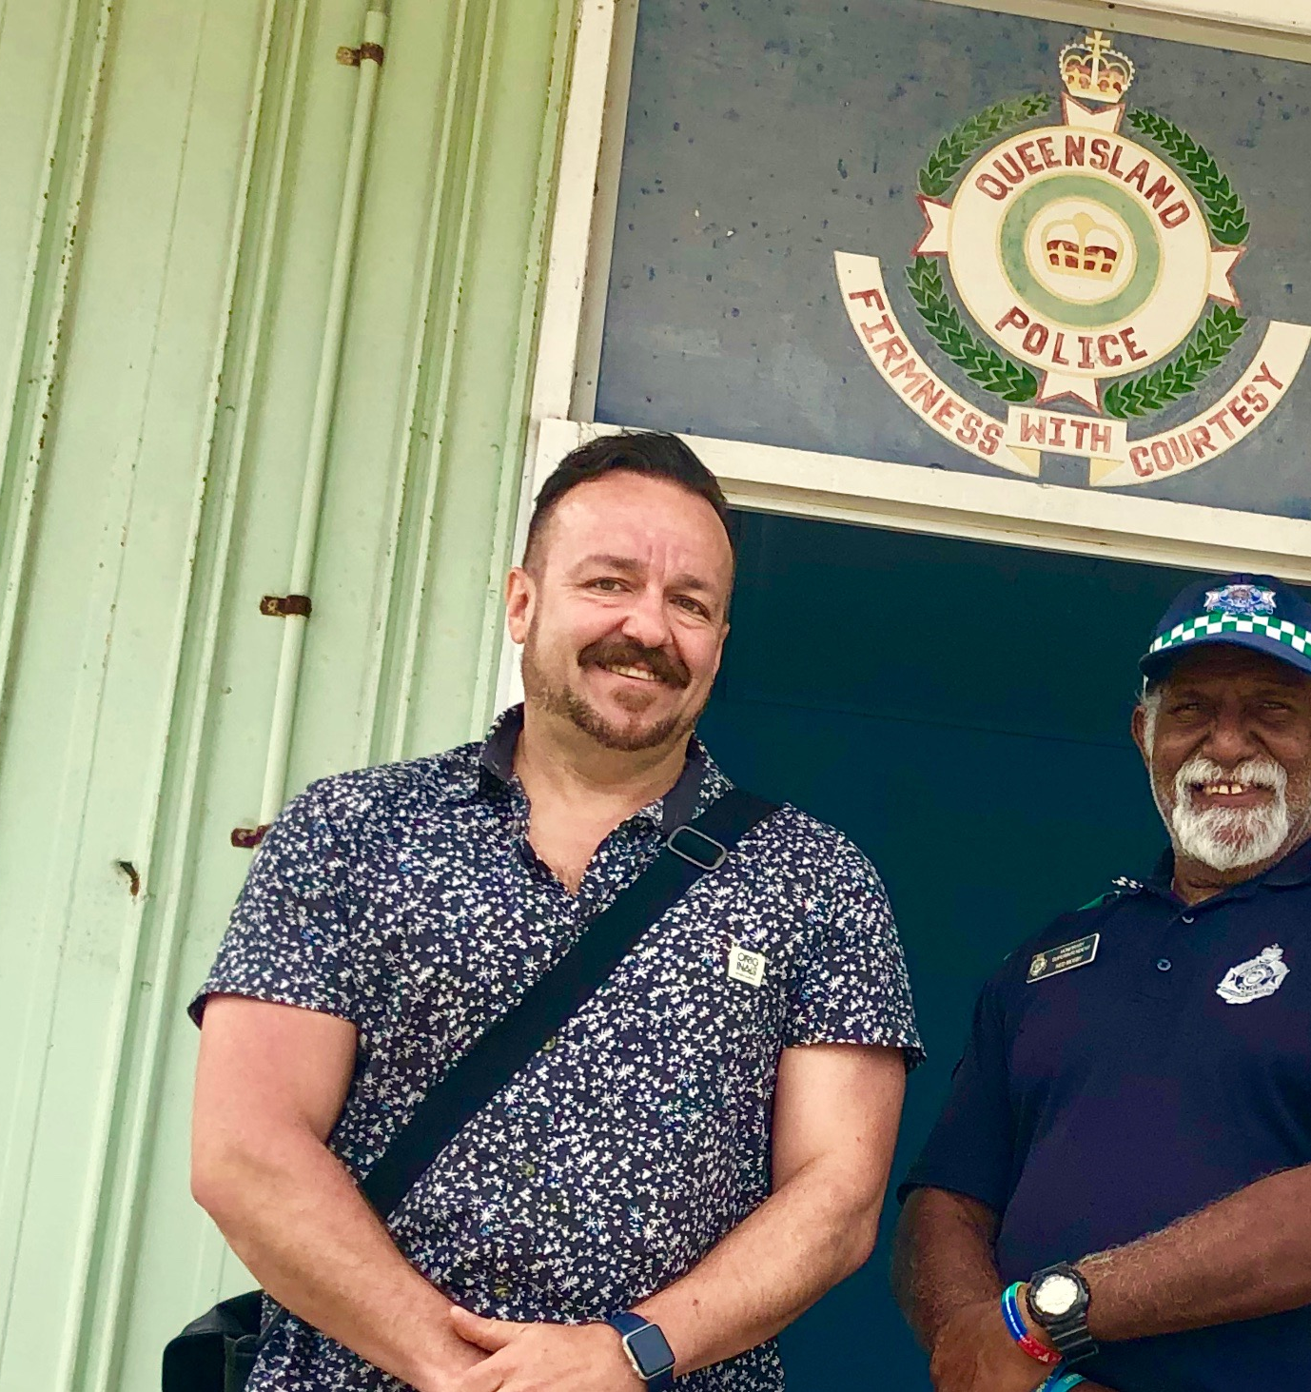
Torres Strait Island Police Support Officers
An important role of the Torres Strait Island Police Support Officers (TSIPOs) is building trust and rapport between police and communities. In this way they were frequently referred to as the ‘eyes and ears’ of the community and were the ‘frontline’ of policing, especially on the outer islands.
Other services also relied on TSIPOs to locate clients and they were also involved in reporting on probation and parole, and community service projects were often run by TSIPSOs.
While their non-sworn roles were critical to crime and justice operations in the TSR, there has also been some local advocacy to provide TSIPSOs with further training, as well as powers of arrest and detention.
While opaque networks may not be crime productive per se, they may indeed enable conditions where crime can remain hidden and be left unaddressed. This was also apparent in the TSR for some types of crime.

Slide 13
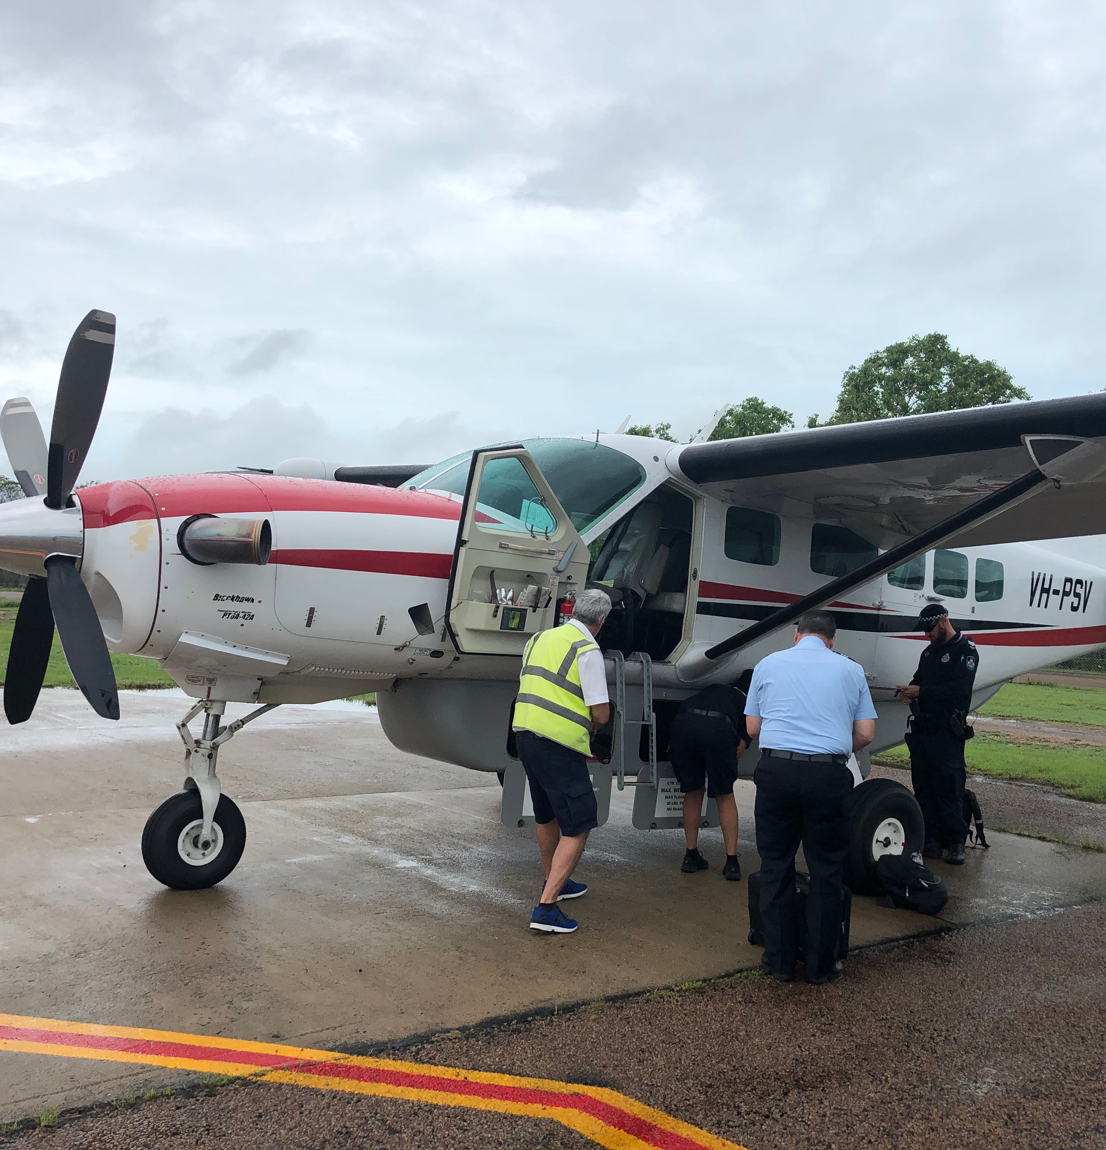
Policing
Police relations with the community were universally cited as being strong and positive.
An important aspect of policing was doing regular visits and stays on the various islands and building relations and trust with community.
The most successful officers integrated well into the local community by engaging in community events and networks.
Policing in the TSR was consistently observed to be distinct from policing on the mainland and police had to adapt to the local cultures and lifestyles. It was also thought that police should be ‘inducted’ into the community when they arrived in the TSR.
Police discretion, given the relatively small size and isolation of some communities, was also important.
Licensing Musters.

Slide 14
Understanding Crime in TSR
The TSR is economically disadvantaged, so it is factors relating to social capital that might explain the relatively low rates of crime in the TSR.
Communitarian societies, which combine a dense network of individual interdependencies with strong cultural commitments of mutuality and obligation, have a significant to lower levels of crime.
Outer Islands have dense social networks with high levels of social capital, but closed networks, with strong bonding capital and little bridging capital. This can produce insularity and intolerance.
In early criminology, high levels of social integration were considered a feature of rural communities. Outer islands resemble homogenous rural settings, with high rates of interpersonal violence.
People are integrated into the normative structure of the community, but what norms define the community?

Slide 15
